Slide 1
CHARGE
PREAMP
ADC
TO BUFFER
DETECTION
TARGET
THRESHOLD
γ

Slide 2
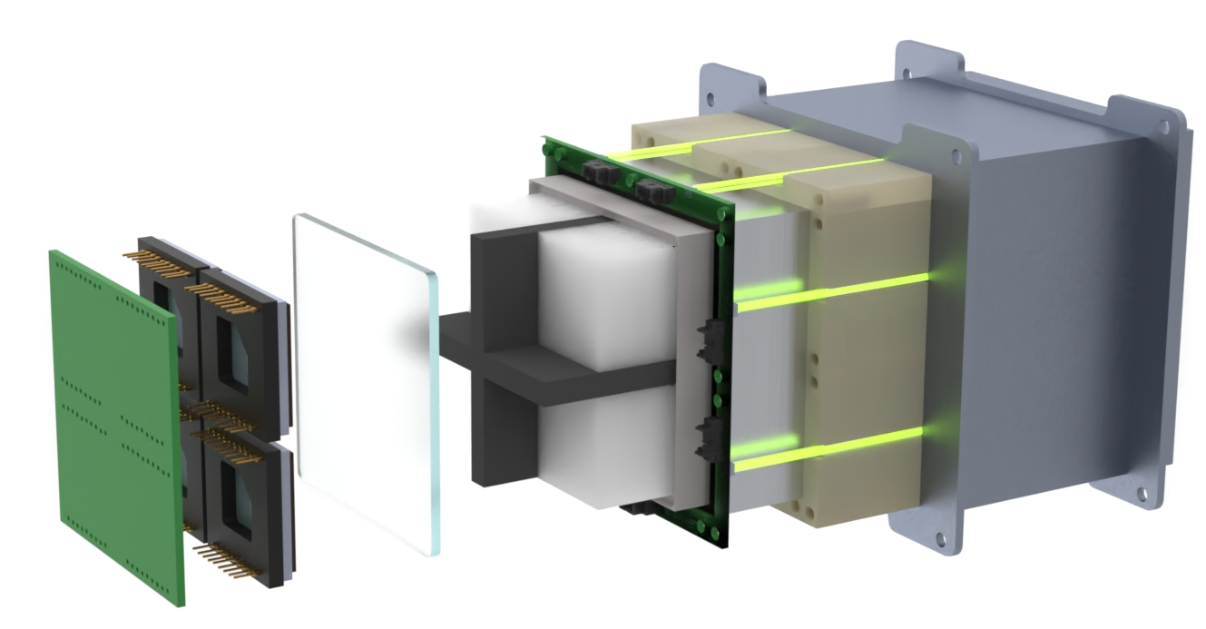
8 VETO SCINTILATORS
Plastic Scintillators
Surrounding the Crystals
4 SCINTILLATING CRYSTALS
READOUT ELECTRONICS
Cerium Bromide
Lanthanum BromoChloride
Custom Power Supply
Charge Pre-Amplifier
SHIFTER FIBER
OPTICAL SEPERATOR
Wavelength Shifter Fiber for Each VETO Scintillator
4 PHOTOSENSORS
Prevents Optical
Crosstalk
Multipixel Photon Counters
Photomultiplier Tubes
VETO SIPM
QUARTZ WINDOW
Silicon Photomultiplier for VETO
Coupling Between Crystals
And Photosensors

